Slide 1
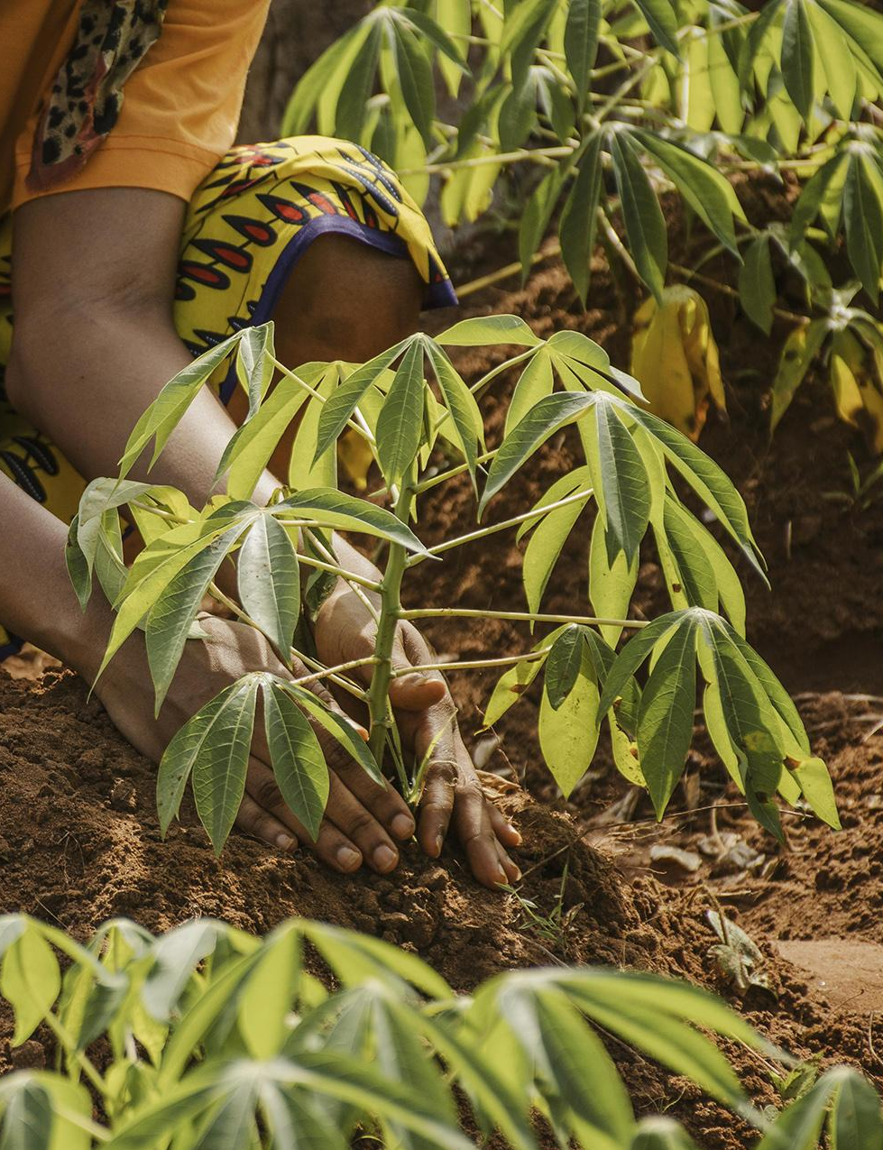
Performance Analysis of Convolutionary Neural Network’s (CNN) and Support Vector Machine’s(SVM) in Predicting Cassava Yields. Case Study Abizard, Arua.
Author: Tabuson Sharifu Nigo,
Land surveyor and Geomatic Engineer

Slide 2
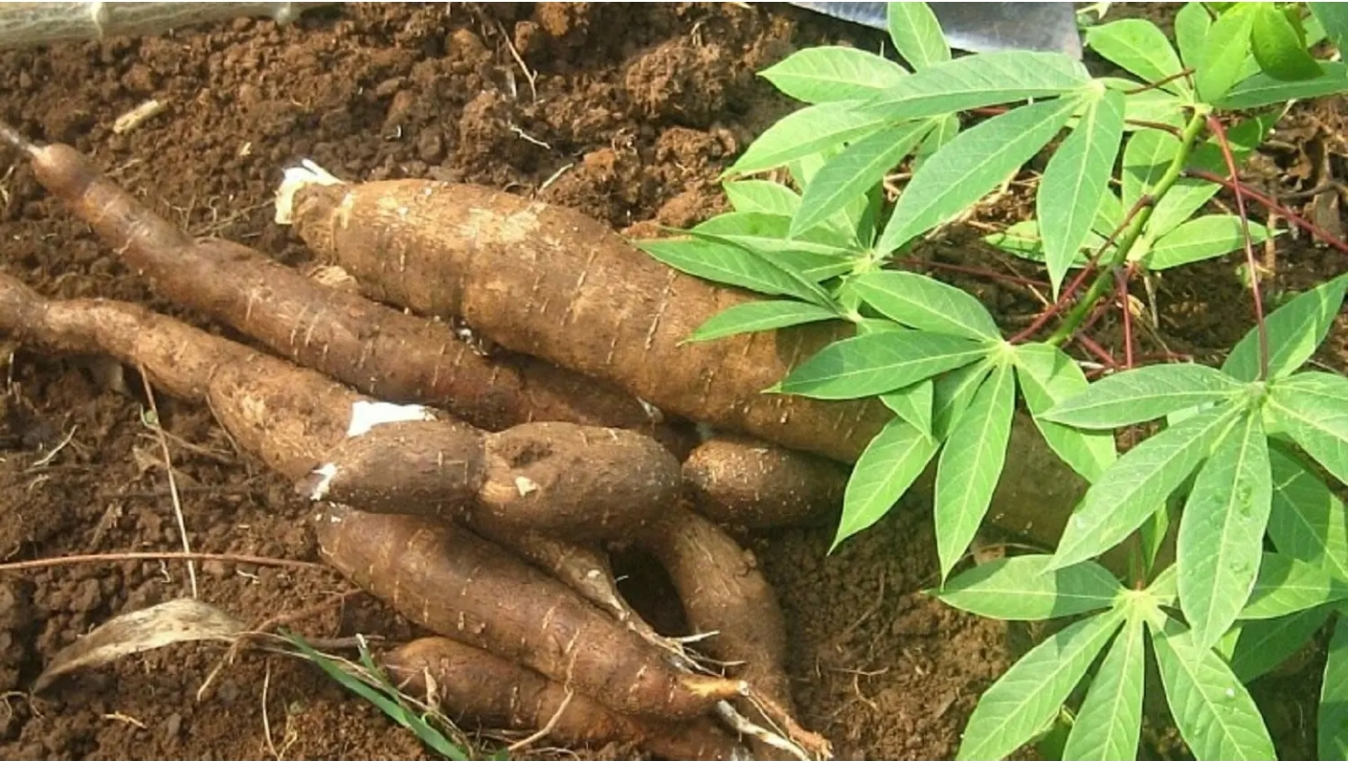
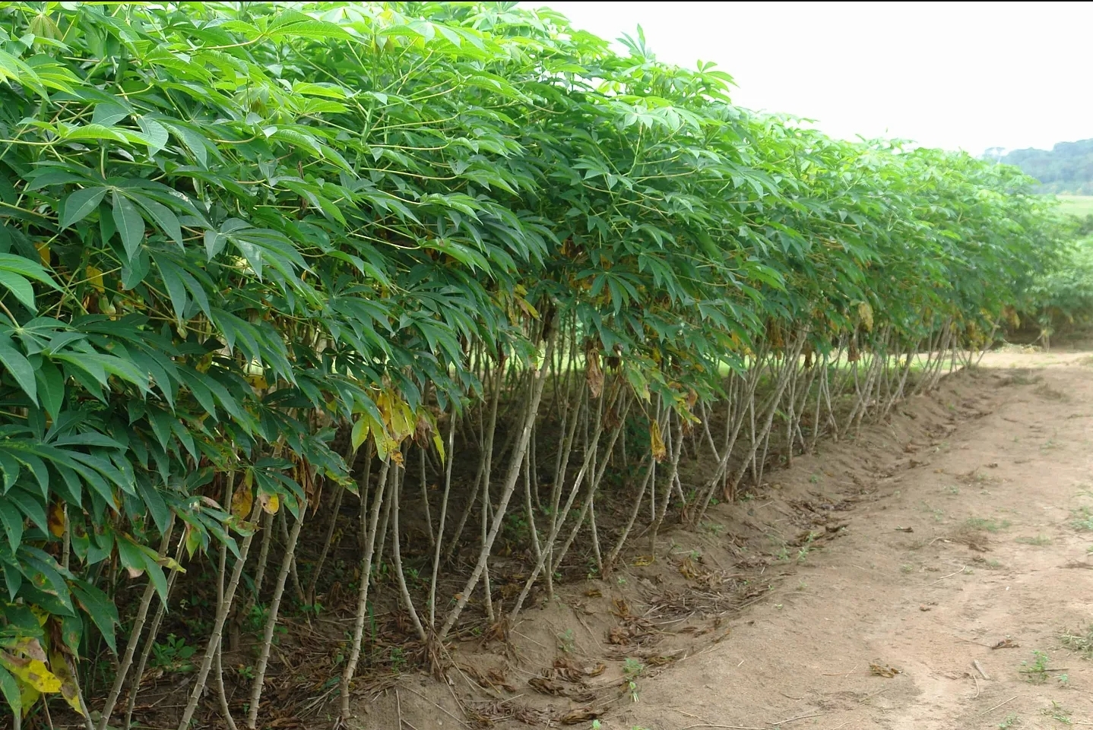
Background
Agriculture plays a pivotal role in addressing global challenges, including food security, poverty reduction, and sustainable development(Science, 2018).
The United Nations’ Sustainable Development Goals (SDGs), particularly SDG 2 (Zero Hunger) and SDG 1 (No Poverty)(Group et al., 2016), underscore the importance of improving agricultural practices to ensure food availability and promote economic well-being.

Slide 3
Background…
At least 80% of small farmer households in Sub-Saharan Africa plant cassava(Li et al., n.d.). This crop has proven its relevance in improving the African economy through increasing exports, job employment and poverty alleviation. According to Cravero (Cravero et al., 2022), this sector has deficient crop yields and low productivity due to uncontrollable diseases frequently affecting plant leaves, poor soil fertility, and unpredictable weather patterns.
Accurate prediction of crop yields is crucial for optimizing resource allocation, enhancing productivity, and mitigating the impact of climate change on food production(Alibabaei et al., 2022).

Slide 4
Background…
While traditional methods of cassava yield prediction exist, their limitations in accuracy, timeliness, and scalability necessitate the exploration of advanced machine learning techniques(Legg et al., 2014).
The research aims to bridge this gap by conducting a comprehensive performance analysis of CNNs and SVMs in predicting cassava yields, offering a novel and technologically advanced approach to address the challenges faced by the agricultural community in Arua.
This research seeks to contribute to the global effort towards sustainable development by harnessing the power of machine and deep learning in improving agricultural outcomes(Sangbamrung et al., 2020), with a specific focus on cassava yield prediction in the region of Arua, Uganda.

Slide 5
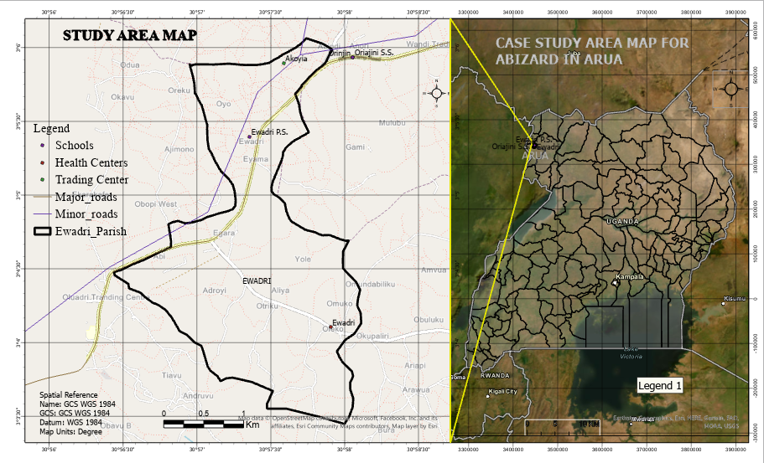
Study area map

Slide 6
Problem Statement
Agriculture is considered an important pillar of the world’s economy and also satisﬁes one of the basic needs of human being,(Alibabaei et al., 2022) i.e. food and income for millions of people.
Cassava is one of the greatest sources of carbohydrates for human food globally. At least 80% of small farmer households in Sub-Saharan Africa plant cassava. This crop has proven its relevance in improving the African economy through increasing exports, job employment and poverty alleviation(Selvaraj et al., 2020).
However, this sector has deficient crop yields and low productivity due to uncontrollable diseases frequently affecting plant leaves, poor soil fertility, and unpredictable weather patterns(Boulent et al., 2019).
Previous studies(Saadio et al., 2022) in plant yield prediction have demonstrated that the recognition of plant diseases is necessary to evaluate the quality of agricultural output, increase market value and meet production standards.

Slide 7
Problem Statement cont…
Traditional methods such as Farmers’ experience and knowledge about observations of plant growth, flowering have been used for generations and hold valuable insights, they are limited by subjectivity, reliance on local conditions, and the inability to scale for large-scale predictions.
Modern technologies, like machine and deep learning algorithms, can complement these traditional methods by providing more accurate and data-driven and real time predictions based on a broader set of variables and integrating with remote sensing data, to allow a more comprehensive understanding of environmental conditions that affect cassava growth(Sambasivam & Opiyo, 2021; Sangbamrung et al., 2020).
This research aims to address this challenge by investigating and comparing the performance of Convolutional Neural Networks (CNN) and Support Vector Machines (SVM) in predicting cassava yields with reference to Arua

Slide 8


OBJECTIVES:
Main Objectives.
To evaluate the performance of CNN’s and SVM’s models in predicting cassava yields.
Specific objectives
To model Cassava yield prediction algorithm based on Support Vector Machines (SVM).
To model cassava-based yield prediction algorithm using Convolutionary Neural Network (CNN).
To compare the performance of CNN and SVM models in predicting cassava fields based on accuracy, precision, recall and F1 score.

Slide 9
The research questions;
• What is the best machine learning algorithms for predicting cassava yields?
• How can SVM model be fine-tuned to adapt to changing agricultural and environmental conditions for more accurate cassava yield predictions over time.
• What role does transfer learning play in enhancing the predictive capabilities of CNN for cassava yield prediction and how can pretrained models be effectively leveraged in agricultural context
Research design;
The study will use a mixed-methods approach, including a survey of cassava farmers in Abi Farm, and a machine learning-based analysis of cassava production data.

Slide 10
Justification
The proposed research project is justified by its potential to address real-world agricultural challenges, harnessing technological advancements, contribution to sustainable development goals, and empowering local communities within Arua and beyond. The outcomes of this research can have far-reaching implications for both the scientific community and the broader agricultural landscape in Uganda.
Critical Agricultural Significance
Technological Advancements in Agriculture
Addressing Food Security Challenges
Climate Change Resilience

Slide 11
Expected deliverables
A comprehensive research report outlining the methodology, results and analysis and conclusions
Trained and validated CNN and SVM models for cassava yield prediction
Feature importance ranking for identifying the most influential factors from yield prediction
Open source code repository containing the implemented models and data processing scripts

Slide 12
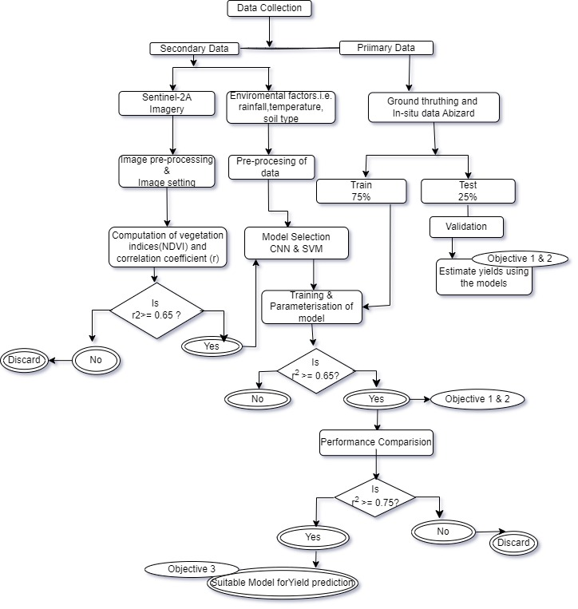
Methodology.

Slide 13
Thanks!
Q & A

